Slide 1
Accelerating Data Engineering Pipelines
Part 2: Extract, Transform, Load

Slide 2
Agenda
Part 1: Data Formats
Part 2: ETL with NVTabular
Part 3: Data Visualization

Slide 3
Agenda – Part 2
ETL Basics
CUDA
NVTabular
Lab

Slide 4
ETL Basics

Slide 5
Data Manipulation in 3 “Easy” Steps
Load
Transform
Extract
Alter the data in some way
Pull data from a database
SQL, Blob Storage, Image Archive
Cleaning, deduping, feature engineering
Export transformed data to a new database location
Notes:
ETL is super easy! All we have to do is Extract, Transform, and Load!

Slide 6
Not So Easy to Optimize
All parts of the technology stack come into play
Individual Machines
Software
Infrastructure
CPU
GPU
RAM
PCIe
Number of servers
Bandwidth
Database location
Python vs C vs SQL
Algorithm efficiency
MapReduce
GPU support
Client location
Notes:
When we investigate optimizing these pipelines to save time and money, it turns out, it’s not so easy.
All parts of the technology stack can affect this process. On the individual machine level, hardware plays a large role. Gamers are aware of this. If one part of the PC is overpowered compared to the others, then a bottleneck occurs, and the extra power does not get utilized.
This can be strongly impacted by the software used to do the data transformation. A library with GPU support can see a huge speedup versus one without, but this also can come down to how the library is written. Traditionally C is faster than Python, but as these languages evolve, the lines between them blur. For instance, the cuDF library which does DataFrame manipulation on the GPU within python is using CUDA under the hood, which was originally intended to support C.

Slide 7
The Most Efficient Pipelines Consider All At Once
Software
Infrastructure
Individual Machine
Notes:
The reason why ETL can be so tricky is that each of these scopes can impact each other. Is it worth it to have a multiple machines if one machine is super powerful? Would we need more hardware if the software was more efficient?

Slide 8
ETL Systems Engineering
Drivers
Promising Leads (Staging)
SQL Join
2 Hours
Calculate Demographics by Car Brand
Python
4 Hours
Calculate Promising Sales Opportunities
Cloud Storage Copy
.5 Hours
Cars
Marketing Leads
Promising Leads (Production)
Notes:
For large data pipelines, practice with systems engineering becomes useful as ETL can often be represented by another DAG. This time, instead of mapping function operations, we are mapping which databases we are extracting from and which databases we are saving to. Traditionally, databases (the extract and load step) are represented by a cylinder whereas processes (the transform step) are represented by a square or triangle.

Slide 9
ETL Systems Engineering
Drivers
Promising Leads (Staging)
SQL Join
2 Hours
Calculate Demographics by Car Brand
Python
4 Hours
Calculate Promising Sales Opportunities
Cloud Storage Copy
.5 Hours
Cars
Marketing Leads
Promising Leads (Production)
Notes:
Visually mapping out the pipeline is useful for a few reasons. First, it helps in identifying bottlenecks. A chain is only as strong as it’s weakest link, and this is true of any DAG. There’s a theory called the Pareto Principle that states 80% of consequences are a result of 20% of the possible causes. In other words, we can greatly improve the speed of our pipeline by eliminating the top few bottlenecks.
Second, this visual representation is also useful for debugging data quality. Some ETL diagrams are more granular, showing which fields from which databases are being processed. If we end up with a bad field in our final dataset, we can work backwards to figure out where the bug came from.

Slide 10
ETL Systems Engineering
Drivers
Promising Leads (Staging)
SQL Join
2 Hours
Calculate Demographics by Car Brand
Python
4 Hours
Calculate Promising Sales Opportunities
Cloud Storage Copy
.5 Hours
Cars
Marketing Leads
Promising Leads (Production)
Notes:
In order to eliminate Single Points of Failure, Reliability Engineers will often add redundancy by duplicating a part of the system. This way, if the original part fails, the duplicate can be used as a backup.
Large databases can make it expensive to use this strategy. Rather than duplicating every part of the system, we might instead focus on duplicating key parts of the pipeline. A popular technique is to create a “Staging” duplicate of the database created in the “Load” step. This way, we can ask a trusted group of users to use this staging database. In exchange for access to new features, these trusted users can warn developers about potential bugs. If there are no bugs, then the Staging database is duplicated to the “Production” database that all users have access to.

Slide 11
CUDA Basics

Slide 12
CUDA Components
Kernels and Threads
Thread Id
Kernel
Thread
A function to run in parallel on the GPU
Runs an instance of the kernel
0 | 1 | 2 | 3 | 4 | 5 | 6 | 7
…
float x = input[threadID] ;
float y = func(x) ;
output[threadID] = y;
…
Kernel Code
Notes:
With CUDA, the worker is a “Thread”. Each thread will get a snippet of code and will repeatedly execute it as data comes through the pipeline.
https://developer.nvidia.com/blog/cuda-refresher-cuda-programming-model/
https://people.cs.pitt.edu/~melhem/courses/xx45p/cuda1.pdf

Slide 13
CUDA Components
Blocks and Grids
Grid
Block
Grid
A group of threads
All blocks mapped on the GPU
Block
…
float x = input[threadID] ;
float y = func(x) ;
output[threadID] = y;
…
…
float x = input[threadID] ;
float y = func(x) ;
output[threadID] = y;
…
…
float x = input[threadID] ;
float y = func(x) ;
output[threadID] = y;
…
…
float x = input[threadID] ;
float y = func(x) ;
output[threadID] = y;
…
Notes:
A group of threads are organized into a block. Blocks run independently and asynchronously, which is what allows the operation to scale. Each block is assigned to a Steaming Multiprocessor.
Blocks themselves are organized into a grid, which spans the GPU.
CUDA kernels are subdivided into blocks.

Slide 14
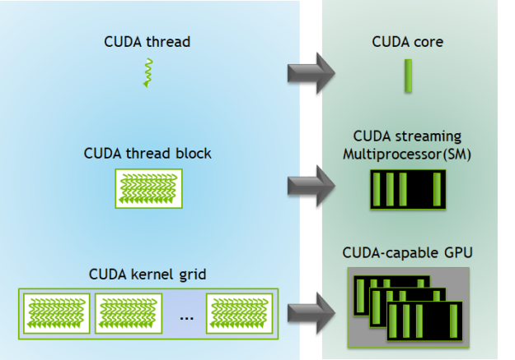
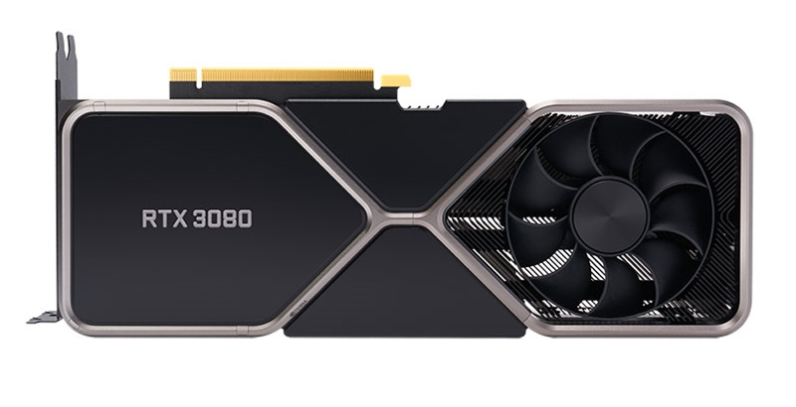
CUDA Components
Hardware to Software
RTX 3080
8704 CUDA Cores
68 Streaming Multiprocessors (SMs)
Notes:
Let’s say we have an RTX 3080 graphics card. It has 8704 cores, which means it can have up to 8704 threads running. Those threads are broken into 68 blocks, which are controlled by a Streaming Multiprocessor. Those blocks form the grid, the entire GPU.

Slide 15
More Cores More Performance?
A Hardware Integration Example
If hardware is not balanced, bottlenecks occur
The right hardware depends on the task
Motherboard
CPU
RAM
Memory Drive
GPU
PSU
Notes:
So what hardware is best for the job? That’s going to depend on what we’re doing. Let’s look at a machine-learning pipeline as an example.

Slide 16
How data Moves In a Computer
A Hardware Integration Example
Motherboard
CPU
1 – 2 Cores per GPU.
RAM
Should be at least a little bigger than GPU RAM. PCIe lane speed can be a factor with massive datasets.
Memory Drive
If the data is too large to be loaded into RAM, then reading speed from the memory drive can be a bottleneck.
GPU
GPUs excel on matrix multiplication computation which is used frequently in ETL and ML model training. RAM speed, GPU speed and Memory Bandwidth can all be a potential bottleneck for computation. Model and data size will impact the efficacy of the GPU.
PSU
There should be enough juice to power all the cool hardware. If it’s not cool, try adding more fans.
Notes:
For machine learning specifically, the bulk of the computation is going to be on the GPU, so the CPU does not have to be top of the line in order to eliminate bottlenecks. There should be 1-2 cores on the CPU per GPU to be able to communicate with each of them.
The RAM should be at least as big as the GPU. We’ll go into depth about this in a little bit, but the short answer is that the RAM sets up a data queue for the GPU for it to be able to pass data. When the GPU is done with a batch of data, it will drop it and ask for the next batch from RAM.
https://towardsdatascience.com/what-is-a-gpu-and-do-you-need-one-in-deep-learning-718b9597aa0d#:~:text=GPUs%20are%20optimized%20for%20training,computation%20of%20multiple%20parallel%20processes.
https://www.mrdbourke.com/notes-on-building-a-deep-learning-pc/
https://timdettmers.com/2018/12/16/deep-learning-hardware-guide/
https://timdettmers.com/2020/09/07/which-gpu-for-deep-learning/
https://www.quora.com/Why-are-GPUs-well-suited-to-deep-learning

Slide 17
How data Moves in a Computer
A Hardware Integration Example
Motherboard
CPU
RAM
Memory Drive
1. CPU tells RAM to load in data from memory drive
2. RAM preprocesses data (ex: prepare images for ml model) and sends to open GPU
GPU
PSU
3. GPU completes backpropagation and sends model updates to host. Requests next batch.
4. Go back to step 1 and repeat until model convergence.
Notes:
Here’s the internal hardware data pipeline.
1. The CPU tells the RAM to load in data from memory drive
2. RAM preprocesses data (ex: prepare images for ml model) and sends to the next available GPU
3. The GPU completes backpropagation and sends model updates to host. Requests next batch.
4. Go back to step 1 and repeat until the model converges

Slide 18
Debugging: Why Is My CPU Faster Than My GPU?
How data moves to the GPU with CUDA
Host
Device (GPU)
DRAM
GPU Chip
CPU
Multiprocessor
Local Memory
Multiprocessor
Multiprocessor
DRAM
PCIe
Shared Memory
Notes:
Without GPUDirect, the GPU’s Multiprocessors (SMs) cannot load data in from disk memory directly. It first needs to be “pinned” in the host’s RAM.

Slide 19
Data movement
CPU vs GPU
CPU-Centric Data Movement
GPU-Centric Data Movement
CPU
CPU
PCIe
PCIe
GPUDirect Storage
GPU 1
GPU 0
Network
Local Storage
GPU 1
GPU 0
Network
Local Storage
NVLink
(same node)
GPUDirect RDMA
Notes:
Talk about PCIe limited bandwidth, bottleneck both CPU and PCIe.
Talk about NVLink on same node, GPUDirect RDMA with multiple nodes, and future GPUDirect Storage.
RDMA Remote Direct Memory Access
PCIe bus around 12GB/s but often less than that in practice due to bus contention (other GPUs, network, disk, etc.)
Sending to a remote GPU will cross the bus a minimum of 4 times (2 each on sender and receiver end).
Important point - get off the high contention PCIe bus.
NVLink: 300 GB/s
PCIe: 12 GB/s, in practice might see 1GB/s because of all the competing traffic
Network: limited by PCIe bus rather than NIC speed up to 100Gb/s.

Slide 20
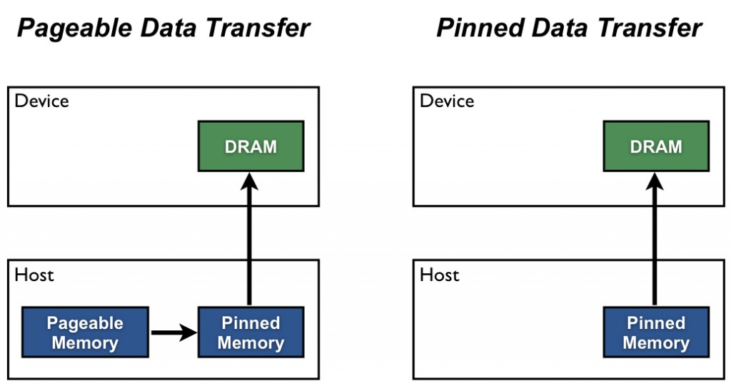
How to Optimize Data Transfers
Notes:
We should not use only the GPU execution time of a kernel relative to the execution time of its CPU implementation to decide whether to run the GPU or CPU version. We also need to consider the cost of moving data across the PCIe bus, especially when we are initially porting code to CUDA. Because CUDA’s heterogeneous programming model uses both the CPU and GPU, code can be ported to CUDA one kernel at a time.
Host (CPU) data allocations are pageable by default. The GPU cannot access data directly from pageable host memory, so when a data transfer from pageable host memory to device memory is invoked, the CUDA driver must first allocate a temporary page-locked, or “pinned”, host array, copy the host data to the pinned array, and then transfer the data from the pinned array to device memory.
We can avoid the cost of the transfer between pageable and pinned host arrays by directly allocating our host arrays in pinned memory.
Do not over-allocate pinned memory. Doing so can reduce overall system performance because it reduces the amount of physical memory available to the operating system and other programs. How much is too much is difficult to tell in advance, so as with all optimizations, test your applications and the systems they run on for optimal performance parameters.

Slide 21
NVTABULAR

Slide 22
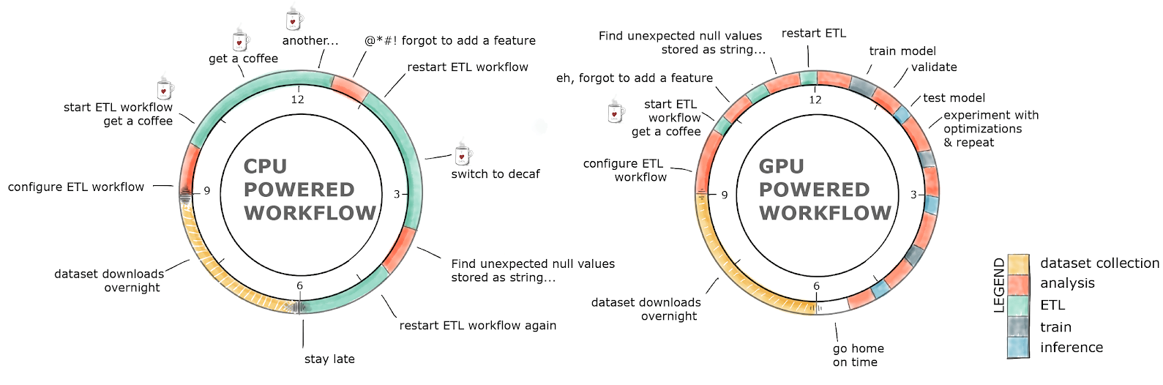
GPU-Accelerated ETL
The average data scientist spends up to 80% of their
time in ETL, as opposed to training models
Notes:
We have noticed that Data Scientists usually spend up to 80% of their time in ETL and feature engineering tasks, instead of designing and fine-tuning their models.
The faster we can complete an ETL pipeline, the easier it will be to debug and the more time we can spend building features.

Slide 23


Built on top of
CPU version
GPU-Accelerated
ETL
Pandas
Analytics
ETL
cuDF
Analytics
Dask
Scikit-Learn
Machine Learning
cuML
Machine Learning
Dask
Model Training
NumPy
Matrix Mathematics
Model Training
CuPy
Matrix Mathematics
CPU Memory
GPU Memory
PyTorch, MxNext, TensorFlow
Deep Learning
PyTorch, MxNext, TensorFlow
Deep Learning
Viz
Matplotlib, Plotly
Visualization
Viz
pyViz, Plotly, cuXfilter
Visualization
www.rapids.ai
Notes:
So, in order to accelerate the ETL part, we have made use of RAPIDS.
RAPIDS is an open source GPU-accelerated framework that tries to cover the E2E pipeline for data science and graph analytics.
On the left side of the slide, we can observe the most used Python libraries.
We perform ETL with Pandas, we train classical machine-learning models with SKL. We use Network X to do graph analytics, and we perform data visualization with Matplotlib or plotly.
In the right side of the slide, we have the equivalent to these libraries, but GPU-accelerated.
The great thing is that these libraries try to maintain the same API as their equivalent CPU-based libraries, making very straightforward to port CPU code to GPUs.
So, we have cuDF, which is the equivalent to Pandas but GPU-accelerated.
We have cuML, which is the equivalent to SKL but GPU-accelerated, containing the most used machine-learning algorithms such as XGBoost, Random Forest, KNN, and many others.
CuPy for Matrix Mathematics.
There are many others, so I would strongly recommend you to visit rapids.ai home page, where you can learn more about RAPIDS framework.

Slide 24

NVTabular Key Features
Faster and Easier GPU-based ETL
GPU-accelerated, eliminating CPU bottlenecks.
Out-of-core execution. No GPU memory limits and reduced I/O through lazy execution.
PyTorch, TensorFlow and HugeCTR compatible.
Filtering outliers or missing values.
Inputting and filling in missing data.
Discretization or bucketing of continuous features.
Creating features by splitting or combining existing features.
Normalizing numerical features to have zero mean and unit variance.
Encoding discrete features using one-hot vectors or converting them to continuous integer indices.
More to come ☺
NVTabular
Dataset size limitation | Unlimited | CPU Memory
Code complexity | Simple | Moderate
Lines of code | 10 - 20 | 100 - 1000
Flexibility | Domain specific | General
Data loading Transforms | Yes | No
Inference Transforms | Yes | No
Notes:
So, it is fair to question how we can do so well.
The straight answer is that we are making use of GPUs, and GPUs perform really well on this kind of tasks.
Then, we have also created a specific-domain API, which allows you to do the same with fewer lines of code.
Finally, we have also introduced new data loaders. They allow loading the data into GPU memory in a very efficient way.

Slide 25
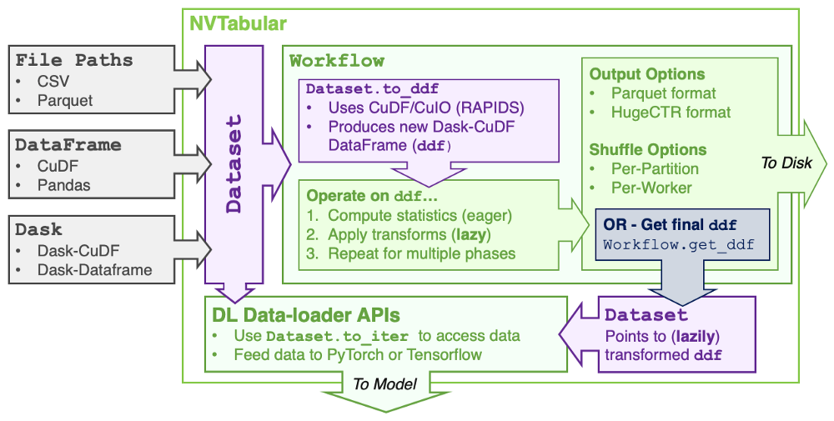
NVTABULAR
Integration with RAPIDS/DASK
Notes:
Workflow — Used to define the desired data-transformation pipeline.
DataLoader — Used to feed a tabular data source to a DL training/inference framework (Accessed through PyTorch or Tensorflow-based frontend).
Dataset— Used to specify the data source for (1) and (2)

Slide 26
NVTabular vs Pandas code
100x fewer lines of code required
import glob
import nvtabular as nvt
# Create datasets from input files
train_files = glob.glob("./dataset/train/*.parquet")
valid_files = glob.glob("./dataset/valid/*.parquet")
train_ds = nvt.Dataset(train_files, gpu_memory_frac=0.1)
valid_ds = nvt.Dataset(valid_files, gpu_memory_frac=0.1)
Import libraries.
Create training and validation datasets.
# Initialise workflow
cat_names = ["C" + str(x) for x in range(1, 27)] # Specify categorical feature names
cont_names = ["I" + str(x) for x in range(1, 14)] # Specify continuous feature names
label_name = ["label"] # Specify target feature
proc = nvt.Workflow(cat_names=cat_names, cont_names=cont_names, label_name=label_name)
Initialise workflow specifying categorical, and continuous data.
Equivalent Pandas/Numpy code:
https://github.com/facebookresearch/dlrm/blob/master/data_utils.py
# Add feature engineering and pre-processing ops to workflow
proc.add_cont_feature([nvt.ops.ZeroFill(), nvt.ops.LogOp()])
proc.add_cont_preprocess(nvt.ops.Normalize())
proc.add_cat_preprocess(nvt.ops.Categorify(use_frequency=True, freq_threshold=15))
Zero fill any nulls, log transform and normalize continuous variables.
Encode categorical data.
# Compute statistics, transform data, and export to disk
proc.apply(train_dataset, shuffle=True, output_path="./processed_data/train", num_out_files=len(train_files))
proc.apply(valid_dataset, shuffle=False, output_path="./processed_data/valid", num_out_files=len(valid_files))
Apply the operations, creating new shuffled training and validation datasets.
Notes:
With this slide, I just wanted to highlight how easy is to use NVTabular.
This example constructs a data pipeline with feature engineering with fewer than 25 lines of code.
I am not getting today into the code details, but here you have it for your reference.

Slide 27
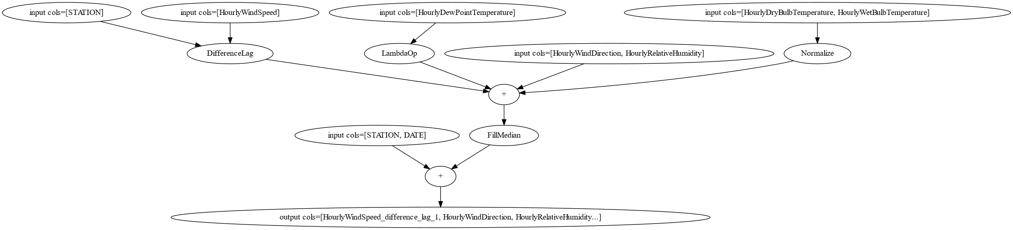
NVTabular DAG
= NVTabular Operations
Notes:
Being built on Dask, NVTabular has a graphing tool to see the DAG as it’s being built. This is the full system we will be building.

Slide 28
Case Study: 1TB Ads Dataset
ETL 660x faster. Training 96x faster.
ETL
Training
Length in minutes, log scale.
CPU: AWS r5d.24xl, 96 cores, 768 GB RAM
GPU: 1 x NVIDIA V100 32GB
https://github.com/NVIDIA-Merlin/NVTabular/blob/master/examples/criteo-example.ipynb
Notes:
Let’s start with an example that showcases how well NVTabular performs.
In this example, we are using Criteo DataSet, and we are comparing how to perform the ETL and training steps with different technologies and hardware configurations.
The first results are executed on CPUs and with the original DL-based recommender system.
The ETL part takes around 5.5 days to execute, and the training part takes around 2 days.
That is a lot. And we can do better.
If we try now to perform the ETL on a CPU based spark cluster, and the training part using PyTorch and GPUs, we are able to complete the ETL in around 3 hours, and the training in around 1 hour.
That is a really good improvement.
But we can do still better.
By performing the ETL with NVTabular, and the training with HugeCTR, we are able to complete the E2E process in around 42 minutes. That is impressive.

Slide 29
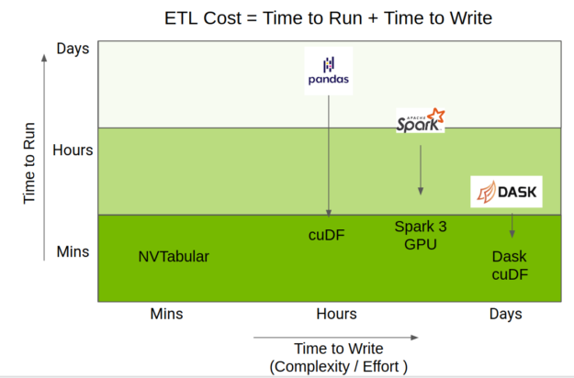
NVTABULAR
Position compared to other popular DataFrame libraries
Notes:
The total time taken to do ETL is a mix of the time to run the code, but also the time taken to write it. The RAPIDS team has done amazing work accelerating the Python data science ecosystem on GPU, providing acceleration of pandas operations through cuDF, Spark through GPU capabilities of Apache Spark 3.0, and Dask-pandas through Dask-cuDF.
NVTabular uses those accelerations but provides a higher-level API focused on recommender systems, which greatly simplifies code complexity while still providing the same level of performance.
NVTabular has three main advantages:
Performance: Lazy execution and GPU-acceleration improve performance up to 10x.
Scale: Dataset operations scale beyond GPU/CPU memory.
Usability: Fewer API calls are required to accomplish the same processing pipeline.

Slide 30
Let’s go!

Slide 32
Appendix
Notes:
The following slides will not be presented by default, but are available as supplementary material.

Slide 33
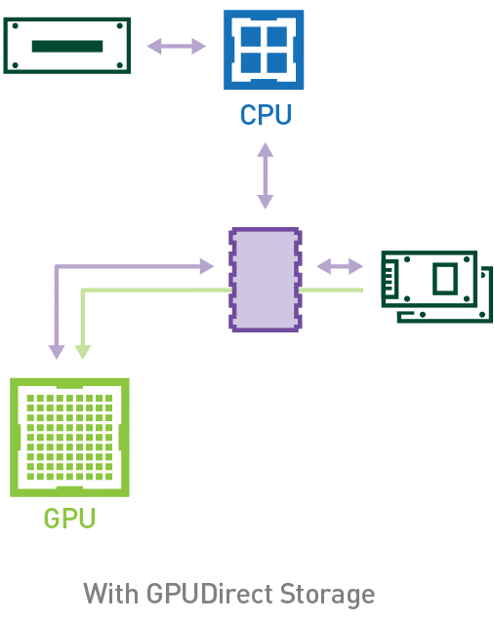
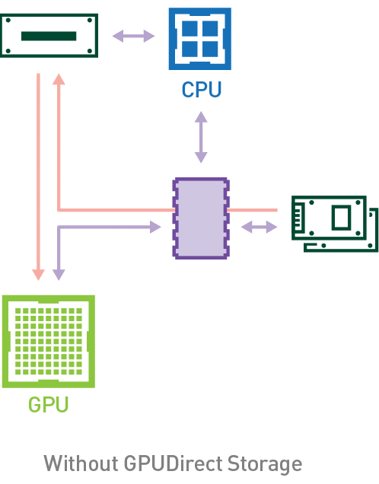
GPU
Another Hardware Integration Example
Without GPUDirect
With GPUDirect
Notes:
GPUDirect was made to bypass the DRAM bottleneck in order to move data directly from disk memory to the GPU. Is this better? As always, it depends. The GPU sees significant speedups with matrix manipulation, so if that’s the bottleneck of a data pipeline, then GPUDirect could be a potential solution. On the other hand, with GPUDirect, DRAM would sit mostly idle. Other types of workloads not heavy on matrix manipulation might benefit from including this computational resource.
https://developer.nvidia.com/gpudirect

Slide 34
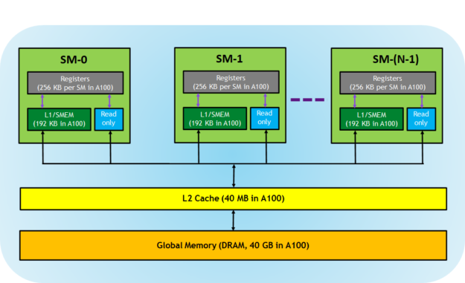
Memory Hierarchy in GPUs
Notes:
Registers—These are private to each thread, which means that registers assigned to a thread are not visible to other threads. The compiler makes decisions about register utilization.
L1/Shared memory (SMEM)—Every SM has a fast, on-chip scratchpad memory that can be used as L1 cache and shared memory. All threads in a CUDA block can share shared memory, and all CUDA blocks running on a given SM can share the physical memory resource provided by the SM..
Read-only memory—Each SM has an instruction cache, constant memory, texture memory and RO cache, which is read-only to kernel code.
L2 cache—The L2 cache is shared across all SMs, so every thread in every CUDA block can access this memory. The NVIDIA A100 GPU has increased the L2 cache size to 40 MB as compared to 6 MB in V100 GPUs.
Global memory—This is the frame buffer size of the GPU and DRAM sitting in the GPU.

Slide 35
Parts of an ETL Pipeline
Purpose
Send instructions to other parts of the system
Parallelize calculation
Individual Machine
CPU - Host
Devices – GPUs
Cloud Servers
Controller Server
Workers
Data storage
PCIe
Bandwidth
Data transfer
Disk Memory
Database server
Notes:
When we look inside our computers, the components of an efficient data pipeline are not that different from how a server based (or cloud) data pipeline works.
There is usually a “Controller” that organizes the entire pipeline and orchestrates what the other parts of the pipeline should do. There are “workers” who take commands from the controller and executes instructions. The workers get their data from some type of storage that must physically travel to them.

Slide 36
Kernels and Pageable Memory
Why they do not work together
Kernel requests pageable data from disk memory
Data does not exist.
Kernel restarts user-defined code.
Page fault handler not loaded, fault not handled
Infinite loop.
Kernel asks page fault handler to fetch data.
Notes:
Pageable memory is an OS level data structure that moves data between disk memory and RAM. We might ask why the GPU CUDA kernel does not use that memory directly. Here’s why.
Let’s say the kernel requests a page of data, but it doesn’t exist. It’ll ask the page fault handler to fetch it. The kernel doesn’t expect a response from the fault handler, so it’ll just restart moving through the user-defined code.
If the page fault handler is not loaded yet, then the kernel’s request was not handled, so it will run into the same problem again and cause an infinite loop.
It’s just like this gentleman here shouting for something to get fixed, but no one is around to hear that something needs fixing ☹
https://en.wikipedia.org/wiki/Memory_paging
https://www.quora.com/What-is-the-difference-between-pageable-and-non-pageable-memory-Is-user-memory-space-pageable-or-non-pageable

Slide 37
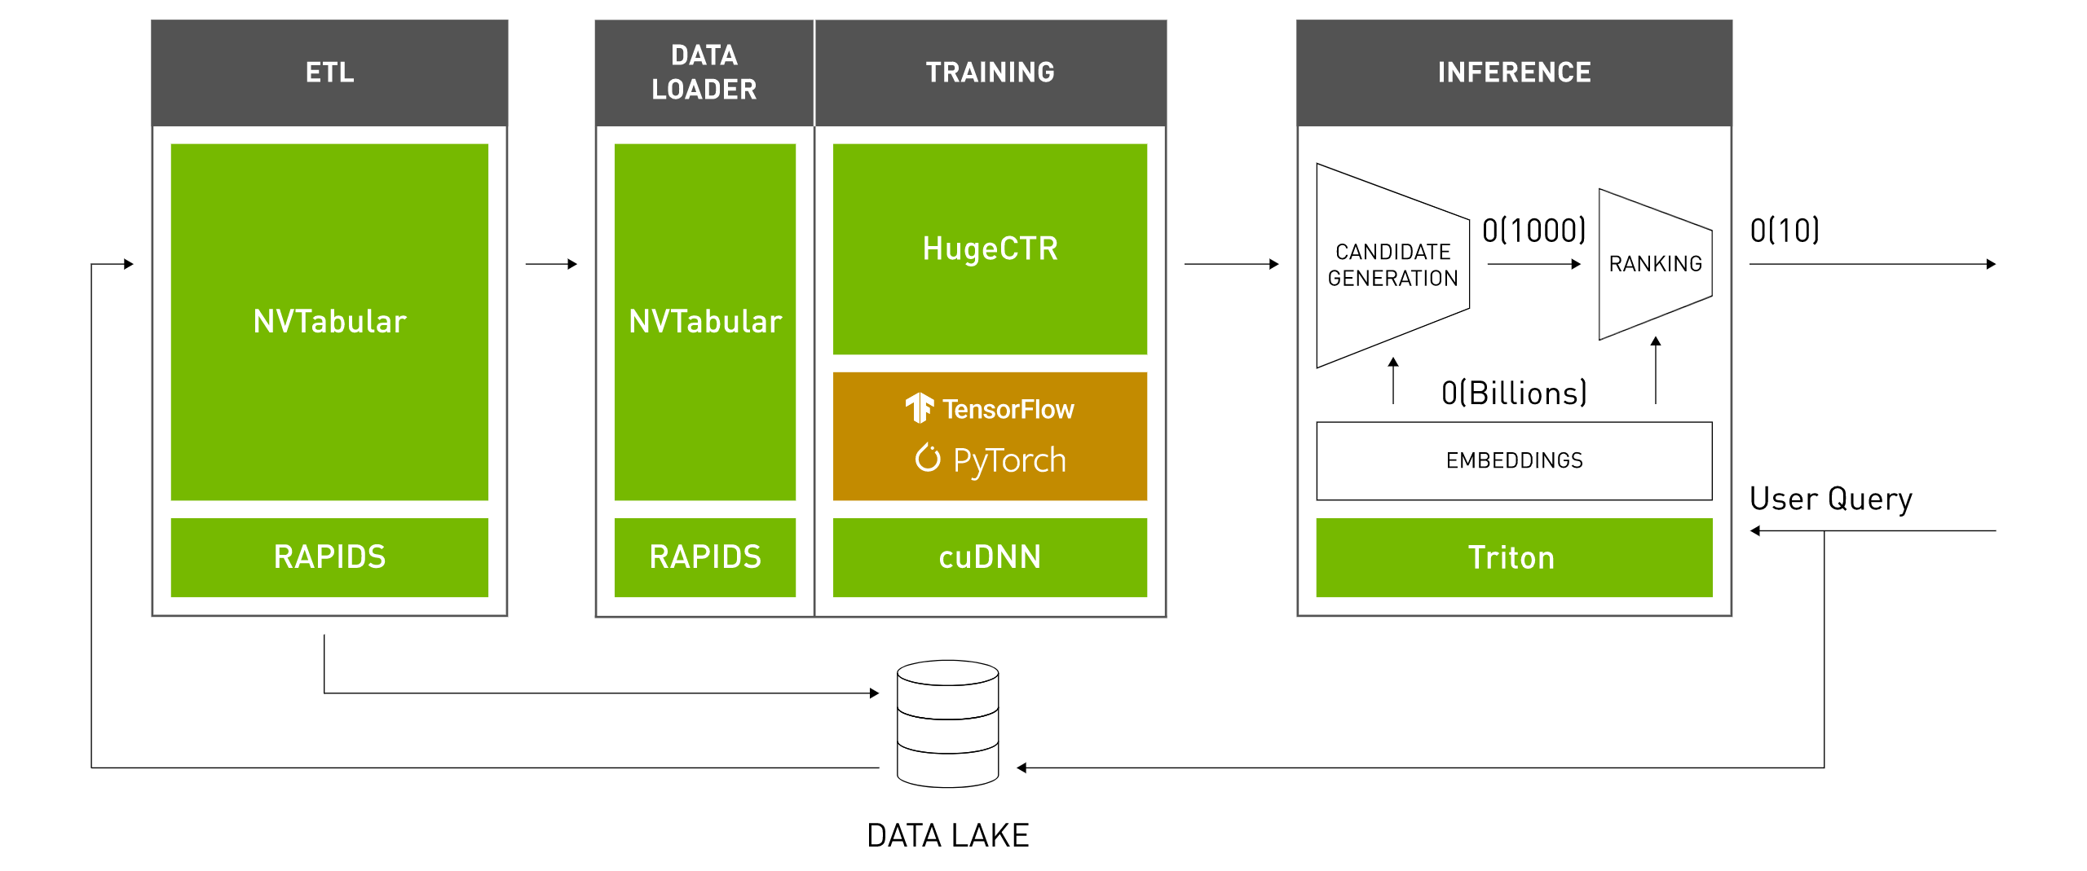
Big Data For Retail
Notes:
NVTabular was created to solve the challenge of Recommender Systems for retail. Let’s say we have millions of users and tens of thousands of products. How do we go about recommending our products to users? If we look at each product for each user, that is billions of possibilities!
Building such a pipeline to run within a day or two so users can see their personalized recommendation in under a second is one of the most complicated and interesting modern day data engineering problems. We are going to focus on the big data aspect of this problem, which is, how do we clean data and add useful features across large datasets?

Slide 38
Working with NVTabular
Workflow
Step 1:
Define Column Group
Step 1:
Define Column Group
Step 3:
Define Graph as Workflow
cols = [“col_a”, “col_b]
Step 2:
Transform Columns with Ops
Step 4:
Run Data through Workflow
cleaned_cols =
cols >> ops.FillMissing()
Notes:
NVTabular works very similarly to Dask (it is built on top of it).
We will start by defining a graph, specifically with the columns of data we want to manipulate from our data sources. This group of columns is called a … ColumnGroup.
We can then manipulate these columns with ops. There are a number of built-in ops like “Clip” and “Bucketize”, but a more powerful Op is a LambdaOp, which allows us to define our own function. This function works just like the map part of MapReduce, so it can only work across a row of data.
Once our graph is set up, we can run a dataset through our graph, and export the result to a file format of our choosing.

